Slide 1
TREATING PATIENTS WITH LUMBAR DEGENERATIVE DISC DISEASE (DDD)
Dr. _________________
[Name of Practice]
TG-186 rev 1 (09/2021)

Slide 2
Overview & Introduction
Low Back Pain
What is Degenerative Disc Disease (DDD)?
Advancements in Treatment Options
When to Refer a Patient to a Spinal Surgeon
1
2
3
4
Treating Patients with Lumbar Degenerative Disc Disease (DDD)
2
v

Slide 3
Low Back Pain
According to researchers, 15% - 20% of adults have back pain during a single year and 50% - 80% will experience back pain in their lifetime¹
Back pain is one of the most common reasons for missed work.²
Most often caused by muscle strain
Only a small percentage of cases ultimately require surgery
Rubin Dl. Epidemiology and Risk Factors for Spine Pain. Neurol Clin. 2007; May;25(2):353-71.
Vallfors B. Acute, Subacute and Chronic Low Back Pain: Clinical Symptoms, Absenteeism and Working Environment. Scan J Rehab Med Suppl 1985; 11: 1-98.

Slide 4
Degenerative Disc Disease (DDD)
Healthy Disc
DDD is part of our natural aging process or may be initiated by an acute injury
Degenerated discs lose structural integrity and ability to provide cushioning
DDD may result in low back pain and/or nerve pain as the degenerative cascade progresses
Degenerative Disc
Nerve Pressure

Slide 5
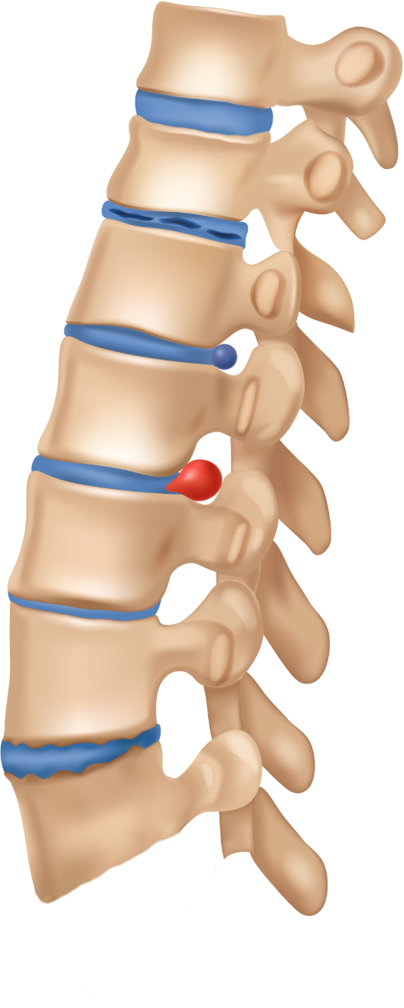
DDD Cascade
Normal Disc
Degenerated Disc
Loss of Disc Height
Increased Instability
Change in Spinal Balance
Increased Load on the Facets/Ligaments
Formation of Osteophytes
Low Back Pain and/or nerve pain
Bulging Disc
Herniated Disc
Thinning Disc
Degenerated Disc with Osteophyte Formation

Slide 6
Interventional/DDD Cascade
SURGICAL INTERVENTION: FUSION
Regain Alignment
Removal of Pain Generator
Decompression of Neural Structures
Restore Disc Height
SURGICAL INTERVENTION: TDR
Maintains Motion
Regain Alignment
Removal of Pain Generator
Decompression of Neural Structures
Restore Disc Height
NON-INSTRUMENTED SURGERY
Removal of Pain Generator
Decompression of Neural Structures
MINIMALLY-INVASIVE CONSERVATIVE CARE
Disrupt Pain Generation
TIME
CONSERVATIVE CARE
Reduce Swelling
Restore Conditioning
Regain Alignment
Removal of Pain Generator
INCREASING PAIN & DEGENERATION

Slide 7
Conservative Care
Examples:
Physical Therapy
Chiropractic
Anti-inflammatories
Diet & Weight Loss
Exercise & Body Mechanics (posture)
Other Lifestyle Modifications
Treatment that does not require an incision or the removal of tissue.³
Goal: Reduce pain, provide conditioning, and manage existing conditions as conservatively as possible.³
3 “Conservative Treatment” Spine Health.com, Veritas Health, November 16, 2021, https://www.spine-health.com/glossary/conservative-treatment

Slide 8
Minimally-Invasive Conservative Care
Examples:
Facet joint injections/blocks
Epidural/steroid injections
Nerve root injections/blocks
The use of selective spinal injections in the treatment of spinal-related pain disorders.⁴
Goals:
The goal of the injection is pain/discomfort relief and/or reducing inflammation
Injection alone may be sufficient to provide relief
Commonly used in combination with a comprehensive rehabilitation program to provide additional benefit
⁴ Evidence-Based Clinical Guidelines for Multidisciplinary Spine Care: Diagnosis and Treatment of Degenerative Lumbar Spinal Stenosis. Burr Ridge, IL: North American Spine Society; 2011.

Slide 9
Non-Instrumented Surgery
Examples:
Facetectomy
Foraminotomy
Laminectomy
Microdiscectomy
Surgical procedures that involve neural decompression without the need for instrumented stabilization.
Goals:
Decompression of neural structures
Removal or mitigation of pain generator

Slide 10
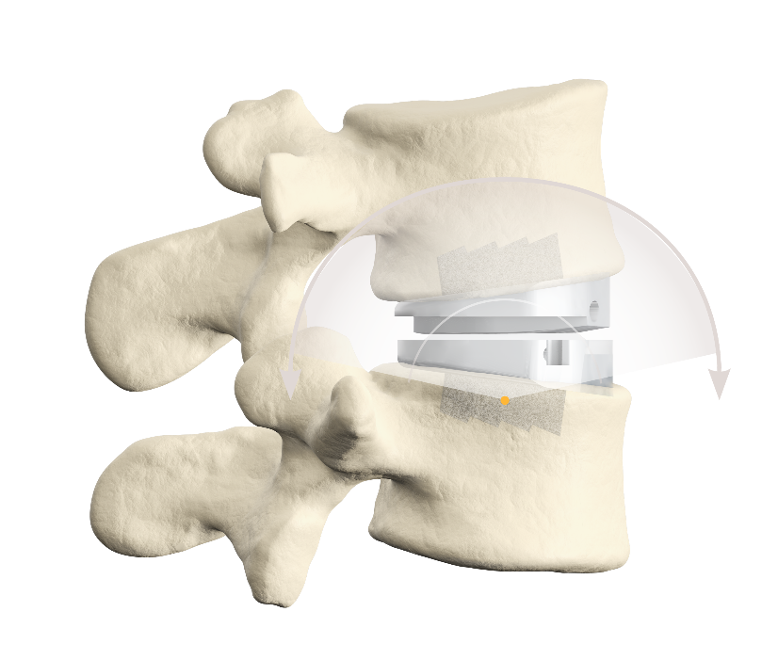
Surgical Intervention: Total Disc Replacement(TDR)
Involves removing the patient’s diseased disc and inserting a device that enables motion at the treated level.
Goals:
Remove pain generator
Neural decompression
Restore disc height
Stabilize motion segment
Enable motion

Slide 11
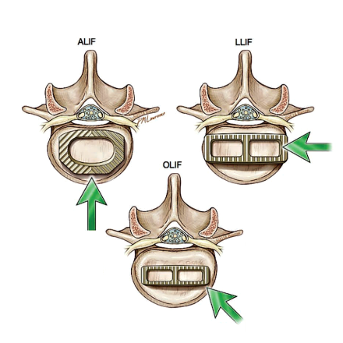
Surgical Intervention: Fusion
Involves removing the patient’s diseased disc and inserting a device that allows bone to grow between the vertebrae. The bone growth fuses the vertebrae together—providing stability by eliminating motion.
Goals:
Remove pain generator
Neural decompression
Restore disc height
Immobilize motion segment
Examples:
TLIF
PLIF
LLIF
ALIF
OLIF

Slide 12
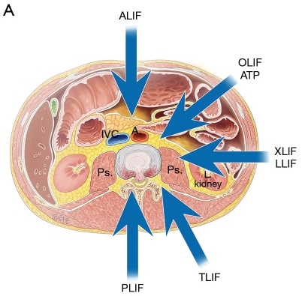
Surgical Intervention: Fusion
Treatment Options:
Anterior Approach
Anterior Lumbar Interbody Fusion (ALIF)
Oblique Lumbar Interbody Fusion (OLIF)
Lateral Approach
Lateral Lumbar Interbody Fusion (LLIF)
Posterior Approach
Transforaminal Lumbar Interbody Fusion (TLIF)
Posterior Lumbar Interbody Fusion (PLIF)

Slide 13
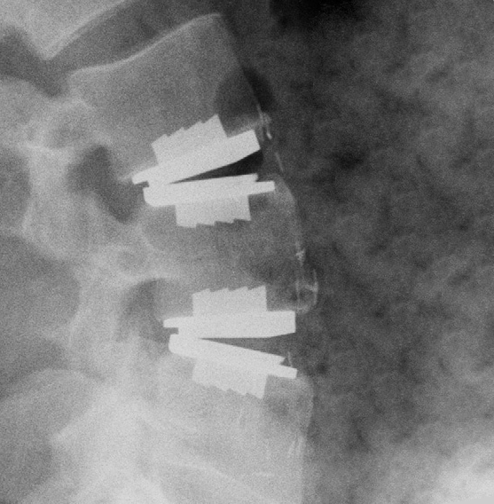
Advancements in Instrumented Surgery (Surgical Interventions)
Total Disc Replacement (TDR)
Device that restores height, enables motion, restores balance and provides stability to the lumbar spine
Does not limit motion between vertebrae
Does not prevent utilization of fusion at a later date
Stand-Alone Anterior Lumbar Interbody Fusion (STALIF)
Device is implanted through a less invasive single incision to provide support for an anterior column fusion
Enables the surgeon to restore disc height and correct sagittal alignment and lumbar lordosis without the need for more invasive fixation

Slide 14
Surgical Intervention Advancements: TDR Benefits
Vertebrae are not fused together
Provides ability to maintain motion
Slows adjacent level degeneration⁵
Faster return to activities of daily living and return to work⁶
Restores sagittal balance and alignment
Maximal Extension
Maximal Flexion
Bending Left
Bending Right
⁵ Zigler JE, et al, J Neurosurg Spine 17:504-511, 2012 ⁶ Tymialan LM, et al. Neurosurg Focus, 2010; 28(5):E18.

Slide 15
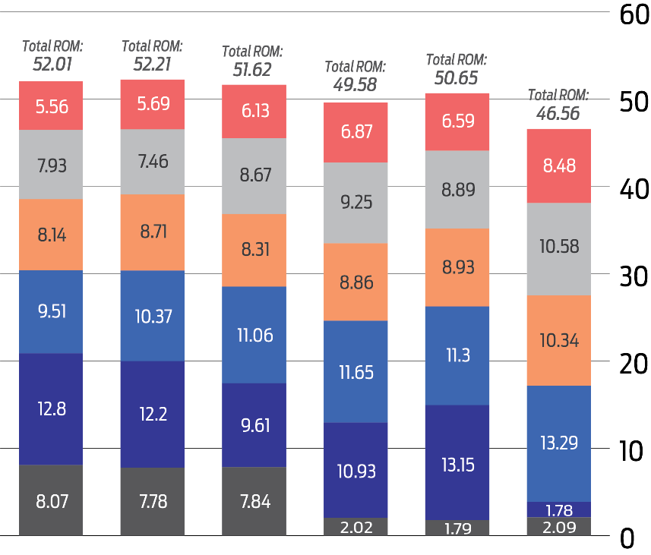
Surgical Intervention Advancements: TDR Benefits
Adjacent Level Effects
TDR constructs show smaller adjacent level effects compared to fusion⁷
Allows for motion to be maintained
7.2° of motion maintained at 5 years⁸
FLEXION-EXTENSION RANGE OF MOTION RESULTS¹
KEY TAKEAWAYS
Relatively similar lumbar spine ROM across all therapies⁷
T12-L1
L1-L2
L2-L3
L3-L4
L4-L5
Fusing level(s) has a significant impact on ROM for adjacent levels⁷
L5-S1
Intact
prodisc L at L5-S1
2 Level Disc
at L5-S1
Hybrid
Disc at L4-L5
Fusion at L5-S1
Fusion
at L5-S1
2 Level Fusion
at L4-S1
⁷ Panjabi, et al. Spine 2007, May 20
⁸ Zigler et al, J. Neurosurgery Spine 17, 493-501, 2012

Slide 16
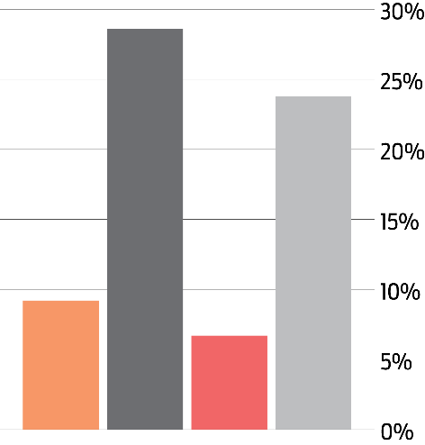
Surgical Intervention Advancements: TDR Benefits
KEY TAKEAWAY
NEARLY 4x LESS LIKELY
For prodisc L patients to experience change in ALDs than 360° fusion patients⁹
Adjacent Level Degeneration (ALD)
Nearly 4x reduction in ALD compared to 360° fusion⁹
Similar results between patients with and without radiographic evaluation of DDD¹⁰
prodisc L Patients with ALD
prodisc L Patients without ALD
Percentage of patients with ΔALD at 5yrs¹
Fusion Patients with ALD
Fusion Patients without ALD
With Pre-Op ALD
Without Pre-Op ALD
⁹Zigler JE, et al, J Neurosurg Spine 17:504-511, 2012 ¹⁰ Zigler et al, J. Neurosurgery Spine 17, 493-501, 2012

Slide 17
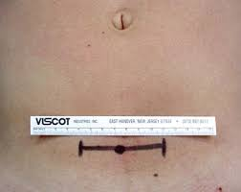
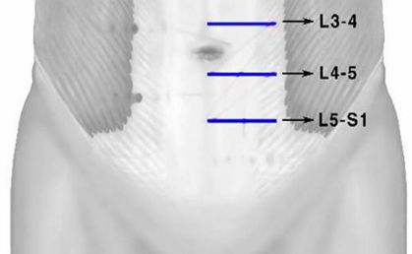
Surgical Intervention Advancements: Stand-Alone ALIF Benefits
Anterior Fusion
Incision made through the abdomen and provides direct access to the spine
Large implant can be placed with minimal soft tissue disruption to eliminate motion while fusion occurs
Approach preserves back musculature and bony structures resulting in less pain and faster recovery¹¹
¹¹ Udby PM, iBech-Azeddine R, Clin Neurol Neurosurg. 2015 Jun;133:64-9

Slide 18
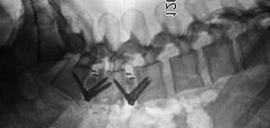
Surgical Intervention Advancements: Stand-Alone ALIF Benefits
Shortened patient recovery^{12,13}
Less blood loss¹⁴
No destruction/destabilization of posterior elements
Large graft area enhances opportunity for fusion¹⁵
Restores sagittal alignment and lumbar lordosis
¹² Outcomes after ALIF versus TLIF for Treatment of Symptomatic L5-S1 Spondylolisthesis: a Prospective, Multi-Institutional Comparative Effectiveness Study, Thompson P, et al, The Spine Journal, 2013 Sep;13(9):S159. ¹³ Clinical outcome of stand-alone ALIF compared to posterior instrumentation for degenerative disc disease: A pilot study and a literature review, Clin Neurol Neurosurg. 2015 Jun; 133:64-9. ¹⁴ Lenz M, et al. Asian Spine J. 2021 Jan 5. ¹⁵ Richter M, Weidenfeld M, Uckmann FP. Orthopade. 2015 Feb;44(2):154-61.

Slide 19
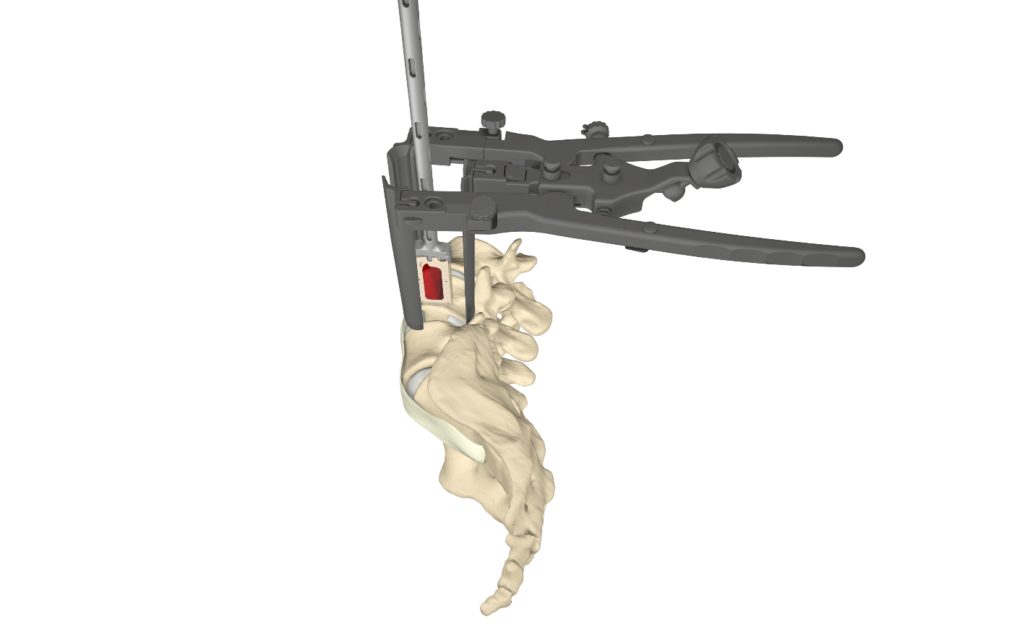
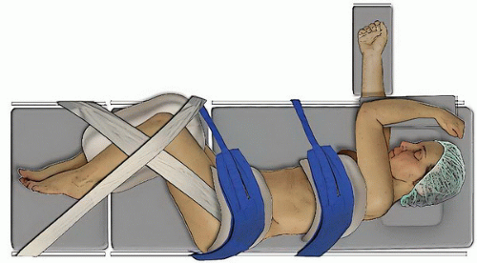
Surgical Intervention Advancements: Integrated Lateral Benefits
Lateral Fusion
Minimally invasive incision made through the Psoas muscle and retracted for access to the lumbar spine
Enables access to higher lumbar spine levels more challenging to reach from anterior approach and for practices without anterior approach surgeon support
Larger implant with lordotic options can be inserted to eliminate motion while fusion occurs

Slide 20
Surgical Intervention Advancements: Integrated Lateral Benefits
Reduced blood loss compared to posterior procedures¹⁶
Less tissue disruption & easier access¹⁷
More complete discectomy, larger cage placement, and more lordosis (compared to PLIF/TLIF)^{18,19}
Shorter operation time, reduced hospital stay, and earlier patient mobilization²⁰
¹⁶ Tien V. Le and Juan S. Uribe (2012). The Minimally Invasive Retroperitoneal Transpsoas Approach, Spine Surgery, Dr. Kook Jin Chung (Ed.), ISBN: 978-953-51-0469-8; http://www.drnesterenko.com/lateral-interbody-fusion/. ¹⁷ Rihn JA, Patel R, Makda J, et al.: Complications associated with single-level transforaminal lumbar interbody fusion. Spine J 2009;9(8):623–629. ¹⁸ Laws CJ, Coughlin DG, Lotz JC, Serhan HA, Hu SS: Direct lateral approach to lumbar fusion is a biomechanically equivalent alternative to the anterior approach: An in vitro study. Spine (Phila Pa 1976) 2012;37(10):819–825. ¹⁹ Ploumis A, Wu C, Fischer G, et al.: Biomechanical comparison of anterior lumbar interbody fusion and transforaminal lumbar interbody fusion. J Spinal Disord Tech 2008;21(2):120–125 ²⁰Shim JH, Kim WS, Kim JH, et al. Comparison of instrumented posterolateral fusion versus percutaneous pedicle screw fixation combined with anterior lumbar interbody fusion in elderly patients with L5-S1 isthmic spondylolisthesis and foraminal stenosis. J Neurosurg Spine 2011;15:311-9.

Slide 21
Benefits Comparison
 | TDR | Stand-Alone ALIF / Integrated Lateral* | PLIF/TLIF
Remove Pain Generators | ✓ | ✓ | ✓
Neural Decompression | ✓ | ✓ | ✓
Restore Disc Height | ✓ | ✓ | ✓
Stabilize Motion Segment | ✓ | ✓ | ✓
Restores Lordosis | ✓ | ✓ | ✓
Restores Sagittal Balance | ✓ | ✓ | ❌
Zero Profile | ✓ | ✓ | ❌
Retains Posterior Elements | ✓ | ✓ | ❌
Allows for Motion | ✓ | ❌ | ❌
Slow the Rate of Adjacent-Level Disease²¹ | ✓ | ❌ | ❌
* No devices are currently indicated for ‘Stand-Alone’ Lateral approach and require supplemental posterior fixation
²¹ Zigler JE, et al, J Neurosurg Spine 17:504-511, 2012

Slide 22
So When Should You Refer a Patient?
The Treatment option available to your patient is dependent upon when you refer them… the sooner the better!

Slide 23
Thank You!

